Slide 1
Demystifying Linux
Penn State IEEE Projects 2022

Slide 2

Member Attendance Award

Slide 3
Getting some downloads started
Notes:
taylor
https://www.virtualbox.org/
https://ubuntu.com/

Slide 4
Roadmap
What is Linux
Setting up a VM
Using the desktop environment
Navigating the filesystem
Basic terminal usage
Program installation
Q&A
Notes:
taylor

Slide 5

What is Linux?
Family of operating systems based on the Linux kernel
Linus Torvalds, September 1991
Unix-like
Different “flavors” of Linux, called distributions
Known for being...
Free
Unfriendly to beginners
Community supported
In a lot of things
Say hi to Tux!
Notes:
will

Slide 6




Distributions
“Flavors” of Linux
Most are general purpose
Many are derived from other distribution
Some common distributions
Ubuntu (Debian-based)
Manjaro (Arch-based)
Linux Mint (Ubuntu-based)
Elementary OS (Ubuntu-based)
And many more!
If you’ve used Linux before, it was probably Ubuntu
Notes:
taylor

Slide 7
Getting set up with a VM
Notes:
will

Slide 8



What’s a VM?
Emulates computer hardware with software
Will be slower than on bare metal
Pretty damn close now, though
Hypervisor
Separates VM from host machine’s hardware
Provisions host resources to VM
What this means for you:
Sandbox PC that you can screw around with without putting your real PC at risk
You can run most OSes on most computers
ARM chip support for most VM software isn’t ready yet
Notes:
will

Slide 9
Getting set up with a VM
Notes:
will

Slide 10
Navigating the desktop
Notes:
taylor
Favorites bar, app launcher, firefox, nautilus, system monitor

Slide 11
Navigating the filesystem with the terminal
pwd
Where am I?
Print working directory
cd [location]
Change directory
“.” is the current directory
“..” is the parent directory
ls [-la]
Show files in current dir
Notes:
will

Slide 12
The Linux file structure
Everything is a file.
Notes:
will

Slide 13
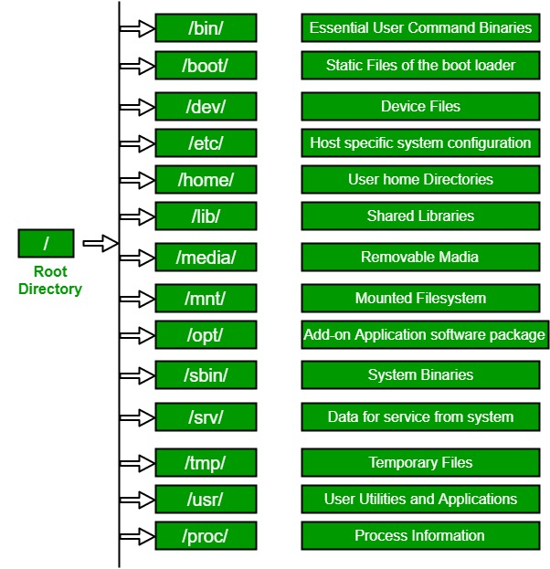
The Linux file structure
Root directory -> “/”
Top level directory that contains all other dirs
Similar to Windows’ “C:\”
Home directory -> “/home/”
Contains user directories
Documents, Downloads, etc.
Similar to Windows’ “C:\Users”
“~” goes to your user directory
Notes:
taylor
etc for config, tmp is useful for temporary directories

Slide 14
Basic terminal usage
echo [text]
Repeat text back to the terminal
touch [file]
Create new blank file
cat [file]
Outputs content of file to terminal
less [file]-- like cat, but better for long files
mkdir [dir]
Make a new directory
rm [-rf] [file]
Remove file
-r required if it’s a directory
-f to force-- be careful
nano [file]
Basic text editor
mv [source] [dest]
Move or rename file
chmod [permissions] [file]
Change file permissions
chmod +x [file] to make file executable
top
Linux’s version of task manager
kill [pid]
Kill process with given pid
man [command]
Get info on how to use a specific command
Notes:
will

Slide 15
Advanced terminal usage
./[executable]
Run executable file in current directory
Files must be run with relative filepath
“./” does the trick
[command] > [file]
“redirect”
Feed output of a terminal command to a new empty file
>> will append instead
[command] | [command]
“pipe”
Feed command output to another command
Bash scripting
Write a series of commands in a .sh file
Run using bash [file] command
Tab autocompletion
Most terminals will try to autocomplete filenames for you
Notes:
will

Slide 16
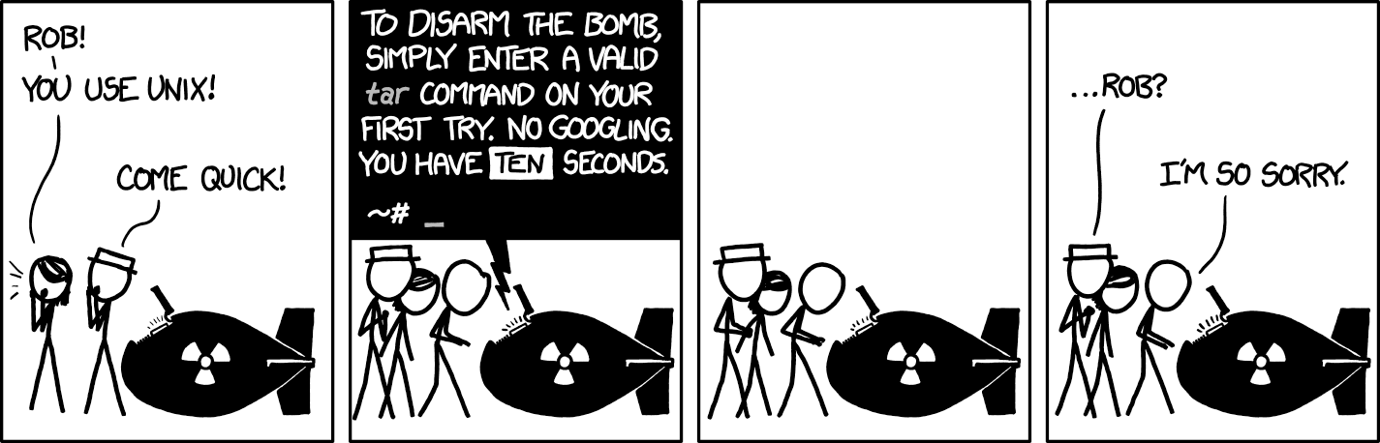
Nobody really knows what they’re doing
Notes:
will

Slide 17
Sudo
Sudo [command]
Superuser do
“Do this command with maximum permissions”
Going to need to enter password
Only certain users on a system can use sudo
BE CAREFUL
Notes:
will

Slide 18
Using package managers
Apt is Ubuntu’s default package manager
90% of the time, you’ll be using apt
Basic steps
sudo apt update
sudo apt install [package]
Snap becoming more popular
More common for more complicated GUI programs
I.e. VSCode, IntelliJ products, etc.
Basic steps
sudo snap install [package] [--classic]
Recommended packages
htop (for when you want a better top)
tree (for when you’re really lost)
cmatrix (for when you are Keanu)
cowsay (for when moo)
vim (for if you hate yourself)
fortune (for fortune)
lolcat (for rainbow text)
sl (for steam locomotive)
Notes:
will

Slide 19
Q&A
Notes:
will taylor

